Slide 1

Gender Inequalities in Journal Authorship
Raag Patel and Roslyn Smith
Advisors: Satvik Ajmera, Dr. Monnie McGee

Slide 2
Why Didn’t God Get Tenure?
He had only one major publication
It had no cited references
It was not published in any peer-reviewed journal
…
- Academic Jokelore

Slide 3
Why Didn’t God Get Tenure?
He had only one major publication
It had no cited references
It was not published in any peer-reviewed journal
…
- Academic Jokelore

Slide 4
Why Didn’t God Get Tenure?
He had only one major publication
It had no cited references
It was not published in any peer-reviewed journal
…
- Academic Jokelore

Slide 5
Why Didn’t God Get Tenure?
He had only one major publication
It had no cited references
It was not published in any peer-reviewed journal
…
- Academic Jokelore

Slide 6
Why Didn’t God Get Tenure?
He had only one major publication
It had no cited references
It was not published in any peer-reviewed journal
…
- Academic Jokelore

Slide 7

Tenure Criteria Examples
Tenure is awarded to those faculty who are outstanding in research/creative activity and whose performance in teaching is outstanding or of high quality. Each department or school should have guidelines that provide greater clarity as to what constitutes outstanding research/creative activity in a given discipline and outstanding or high quality teaching. Tenure cannot be granted on the basis of academic potential alone. Demonstrated accomplishments in research/creative activity and teaching are essential. Tenure is not attained automatically but only through the deliberative process described below and by the final approval of the Board of Trustees. With the awarding of tenure, an assistant professor is promoted to associate professor.

Slide 8

Tenure Criteria Examples
The University’s criteria for granting tenure, promotion, or permanent status shall be relevant to the faculty member’s assignment and to their performance of the duties and responsibilities expected of a member of the university community. These criteria recognize three broad categories of academic engagement:
Teaching – Instruction, including in person classroom teaching, online/distance/executive/continuing education/laboratory/field/ clinical/performance instruction, direction of theses and dissertations, and extension education programs.
Research – Research or other scholarship and creative activities. Reminder: All tenure track faculty must have a minimum of 10 percent of their time assigned to research.
Service – Public and professional.

Slide 9

Tenure Criteria Examples
Candidates for tenure with promotion to Associate Professor are expected to fulfill some combination of the following criteria.
Research/Scholarship
Publication of articles in peer-reviewed scholarly journals during the probationary period.
Publication of a peer-reviewed book (or books) by a reputable publisher.
Publication of chapters in peer-reviewed books and related projects.
…

Slide 10




Methodology
Published Journal Articles
2017 to 2023
APIs and Python Packages
Gender of authors

Slide 11

Data Sourcing
Crossref API
Article Titles
Author Name
Publication Dates
Subject Area
Order of Author
Crossref makes research objects easy to find, cite, link, assess, and reuse. We’re a not-for-profit membership organization that exists to make scholarly communications better.

Slide 12



Key Metrics
476K Unique Articles
500K Unique Author First Names
231
Unique Subjects

Slide 13
Tools
gender-guesser (python): Trained on a list of more than 40K first names and gender covering the vast majority of first names in all European countries and some coverage in China, India, Japan and USA.
Namesex (python): Namesex is a package that predicts the gender tendency of a Chinese given name. It is trained on 10,730 Chinese given names (in traditional Chinese) with reliable gender labels collected from public data.
OpenAI API: The OpenAI API leverages advanced language models trained on diverse datasets to provide a dynamic and versatile approach to gender identification, accommodating various linguistic and cultural nuances.

Slide 14
Gender Distribution Overview Python packages
Gender | Names | Percentage
Male | 5.3MM | 34%
Female | 3.0MM | 19%
Unknown | 7.2MM | 47%
Identified gender for 53% of names
Challenges with names that were not of Anglo-Saxon and Latin origin
64%
Males
36%
Females

Slide 15
Gender Distribution Overview OpenAI GPT API
Gender | Names | Percentage
Male | 8.7MM | 56%
Female | 4.1MM | 27%
Unknown | 2.7MM | 17%
Identified gender for 83% of names
Challenges with output of results and validation
68%
Males
32%
Females

Slide 16
Topic Breakdown
Topic | Number of Articles | Male | Female
Life Sciences | 148.0K | 59% | 41%
Physical and Earth Sciences | 106.8K | 70% | 30%
Engineering | 98.1K | 78% | 22%
Humanities and Arts | 47.9K | 59% | 41%
Psychology and Social Sciences | 40.0K | 59% | 41%
Mathematics and Computer Sciences | 35.3K | 73% | 27%
Total | 476.1K | 66% | 34%

Slide 17
Topic Breakdown
Topic | Number of Articles | Male | Female
Life Sciences | 148.0K | 59% | 41%
Physical and Earth Sciences | 106.8K | 70% | 30%
Engineering | 98.1K | 78% | 22%
Humanities and Arts | 47.9K | 59% | 41%
Psychology and Social Sciences | 40.0K | 59% | 41%
Mathematics and Computer Sciences | 35.3K | 73% | 27%
Total | 476.1K | 66% | 34%

Slide 18
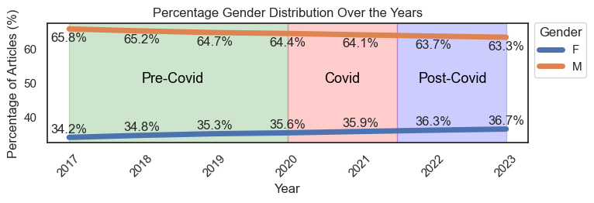
Results
Notes:
This graph looks at how the general distribution of gender authorship takes place over the years we looked at. We wanted to specifically narrow in on Covid, and try to understand if there were any differences that were exemplified during the pandemic. The rate of change was slowing down pre covid, and has now, post covid, started to pick up slightly.
We considered the covid eras, as such. Pre covid would be before 2020, covid through 2022, and anything this year onward as 2023. We can clearly see that the disparity is shrinking, and at this pace we expect parity in 2055. That’s of course not accounting for the recent sharp increases in women holding stem degrees. Biology comment.

Slide 19
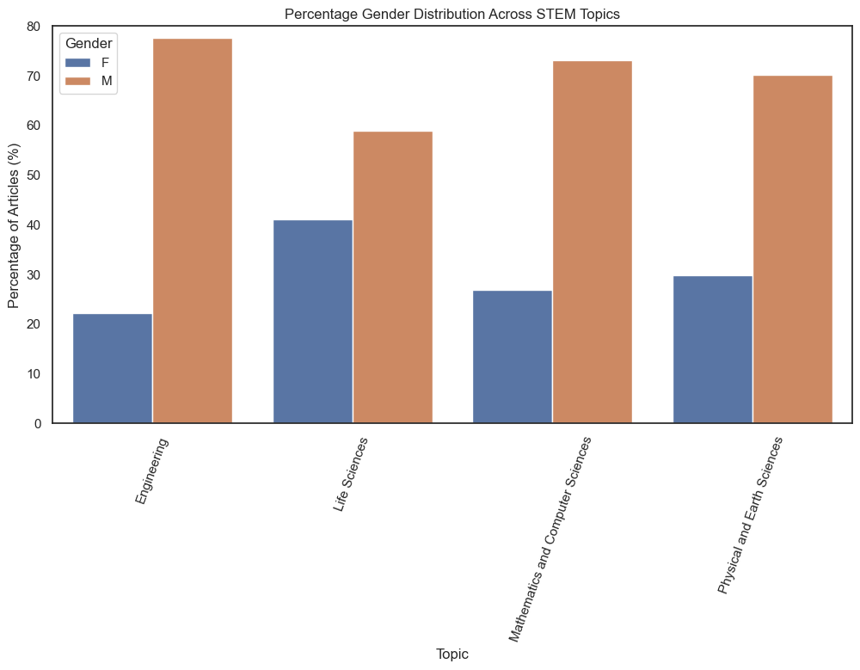
Results
Notes:
Analyzing the first graph, we see a detailed representation of gender authorship across various STEM fields. Starting with engineering, there's a noticeable disparity where only around 20% of articles feature female authors compared to their male counterparts. As we transition to life sciences, there's an increase in female representation, with women contributing to nearly 40% of articles. The fields of mathematics and computer sciences present a distribution akin to life sciences, while physical and earth sciences show an almost even split between male and female authors. Despite these shifts, it's clear that certain STEM areas like engineering continue to experience significant gender disparities. Life Sciences last

Slide 20
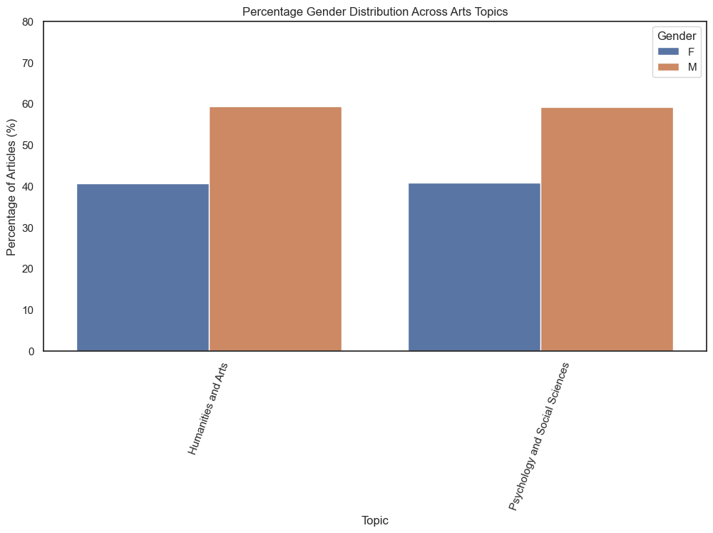
Results
Notes:
"Turning our attention to the second graph, the distribution in humanities and arts and psychology and social sciences is exhibited. Here, both fields display a more balanced gender distribution in comparison to some STEM fields. In humanities and arts, there's a slight edge for male authors, but it's notably closer in representation than what we observed in engineering. Meanwhile, in psychology and social sciences, female authors lead, which resonates with current trends indicating increased female participation in these areas. Reflecting on these insights, it underscores the significance of continued efforts in promoting diversity and inclusivity in all academic domains." End with Bivin Sadler comment

Slide 21
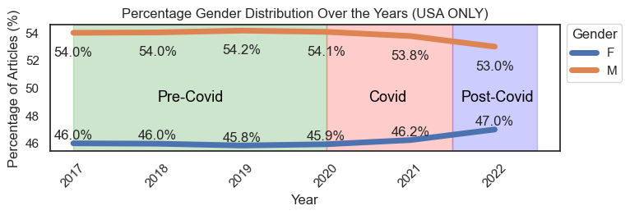
Results
Notes:
Now this graph was pulled with different data. This data is from the NCSES stands for the National center for Science and Engineering Statistics. They recorded every year, how many journals across all the subjects we just talked about were published, solely in the US.
Sharp increase in publication continuing on

Slide 22
Why does it matter
Global and Social Impacts
Mentorship and Academic Lineage
Advancing Gender Equality
Headwinds
End of Affirmative Action
End of American Rescue Plan Act
Mom’s First
Notes:
Women’s underrepresentation in research can have implications beyond academia. For instance, in health research, the lack of female researchers can lead to gaps in understanding women’s health issues. Increased publication by women can ensure that research covers more areas that are niche and catered towards minority groups
Women who publish at the PhD level are more likely to advance in their academic careers and become mentors to the next generation of researchers. This can create a cycle, supporting and inspiring more women to enter and remain In academia.
Increasing the number of women publishing at the PhD level is not just about equality in academia; it's about advancing gender equality more broadly. When women are visible and successful in high-status professions, it can influence attitudes and norms around gender roles in society. •However, we must also be cognizant of the challenges or 'headwinds' facing the academic and publishing landscape. These include the end of Affirmative Action and the conclusion of the American Rescue Plan Act – both of which have had profound implications for research and academia.

Slide 23
Questions?

